Slide 1
SECURE DATA HIDING IN IMAGES USING STEGANOGRAPHY
CAPSTONE PROJECT
Presented By
Student Name : Rutuja Zade
College Name & Department : Kamla Nehru Mahavidyalaya

Slide 2
OUTLINE
Problem Statement
Technology used
Wow factor
End users
Result
Conclusion
Git-hub Link
Future scope

Slide 3
Problem Statement
Security:- Insufficient protection against detection and extraction of hidden data.
Image Quality:- Degradation of data quality due to data embedding.
Capacity:- Limited amount of data that can be hidden within an image.

Slide 4
Technology used
Programming Language:- Python
Image Processing Library:- OpenCV
Platform:-Windows 10

Slide 5
Wow factors
Undetectable Data Hiding :- Steganographic methods that can hide data in images without leaving any detectable traces or artifacts.
Multi-layered Encryption :- Combining steganography with advanced encryption techsniques,such as AES or RSA to provide an additional layer of security.
Steganalysis-Resistant :- Developing steganographic methods that can withstand steganalysis attacks and remain undetectable.

Slide 6
End users
Healthcare Providers:- Research institutions that must safeguard patient records confidential information.
Government & Defense :- Defense organizations that require secure communication and data exchange.
Financial Institutions:- Financial organization that need to protect sensitive customer data and financial transaction.
Supply Chain Management:- Secure data exchange and communication for logistics, and transportation companies.

Slide 7
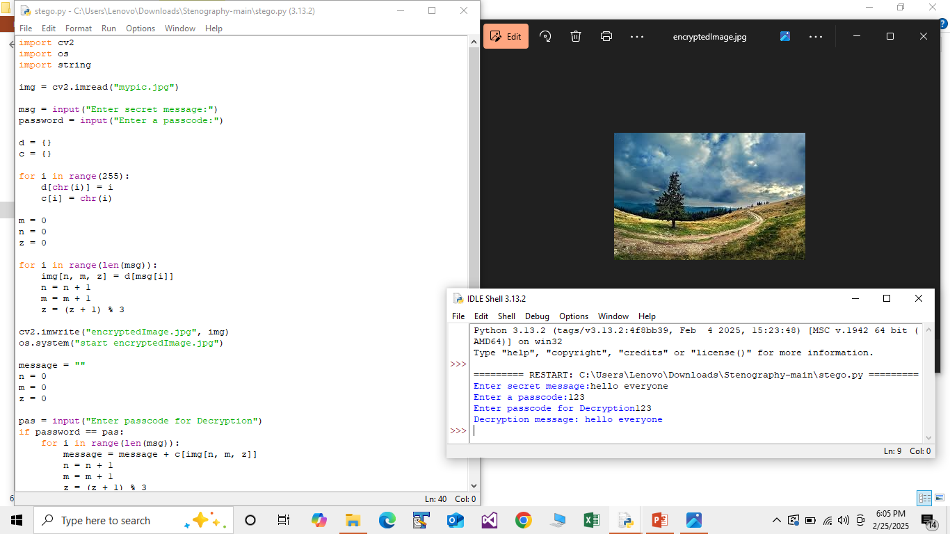
Results

Slide 8
Conclusion
Enhanced Security :- Steganography provides an additional layer of security for sensitive data, making it more challenging for unauthorised parties to access.
Improved Data Protection :- Secure data in images using steganography ensures that sensitive information remains protected, even in the event of data breaches or cyber attacks.
Increased Efficiency :- Steganographic methods can be designed to be computationally efficient, allowing for fast and secure data transmission.

Slide 9
GitHub Link
https://github.com/rutujazade11/aicte-project.git

Slide 10
Future scope(optional)
Advancements in Steganographic Techniques:- Ongoing research and development in steganography will lead to more sophisticated and secure methods for hiding data in images.
Integration with Emerging technologies :- The incorporation of steganography with emerging technologies, such as artificial intelligence and block-chain will further enhance the security and efficiency of secure data in images.

Slide 11
THANK YOU

